Slide 1
ICArUS Pilot Study 1: Facility Identification
MITRE
June 29, 2011
Distribution restriction:
Information in this document, in whole or in part, cannot be released outside of the ICArUS Program without the prior written permission of the ICArUS Program Manager and Contracting Officer.

Slide 2
Overview
Goals
Methods
Results
Metrics used for analysis
Performance
Correct answers (Winner-take-all)
Correct distributions (K-L divergence)
Participant response strategies
Participant learning of individual features
Notes:
Time will be left at end for discussion and questions

Slide 3
Goals
The ICArUS Program will employ a GEOINT-themed Challenge Problem to compare the models’ performance with human performance. This study is designed to:
Assess the ability of human participants to perform nominal sensemaking tasks involving stimuli similar in format to the final Phase 1 CP.
Can people learn to recognize patterns/select a frame in a high-dimensional feature space?
Provide performers with initial sample data (Month 3 T&E Deliverable) to help support early modeling efforts.
Enable the T&E Team to work through important conceptual issues related to CP design.

Slide 4
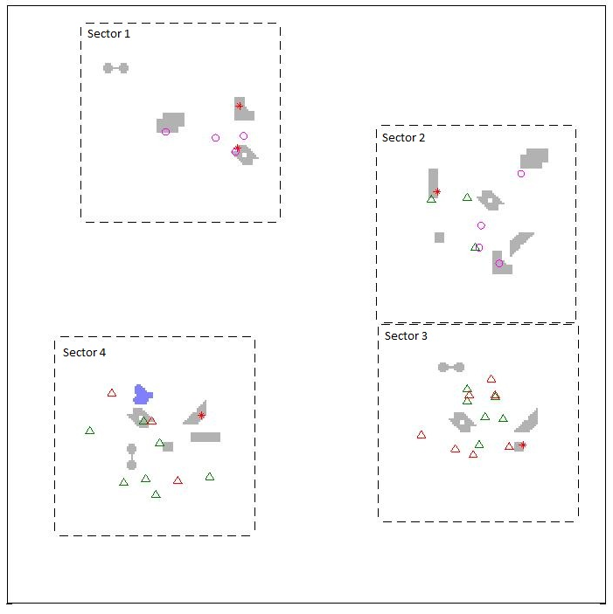
Methods: Facilities
Participants were asked to identify 4 fictitious facilities (Ketchup-, Mustard-, Salt- and Pepper-producing Factories); 2-4 facilities appeared simultaneously in the scene. A facility was comprised of data from multiple layers.
A scene with 4 facilities.

Slide 5
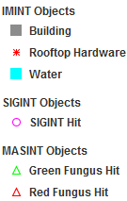
Methods: Data
Three categories of data were associated with the task (IMINT, SIGINT, and MASINT).
IMINT (Image Intelligence): the location and shape of a building, water features, and the presence or absence of rooftop hardware, e.g., a satellite dish.
SIGINT (Signals Intelligence): intelligence gathered by the interception of signals; each ‘hit’ denotes an intercepted signal at that location (e.g., a government-issued cell phone).
MASINT (Measurement and Signature Intelligence): chemical intelligence; each ‘hit’ denotes that a chemical (e.g., green or red fungus) has been detected at that location.

Slide 6
Methods: Questions
Data was presented:
simultaneously (all at once)
sequentially (one layer at a time)
or sequentially based on user choice (participants were given a choice of which data to see next).

Slide 7
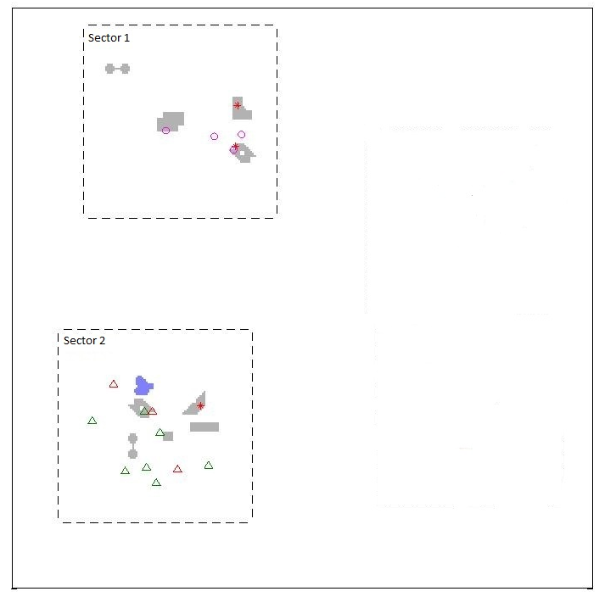
Methods: Questions
The test comprised of a series of multiple-choice questions, and all responses were in the form of likelihoods (e.g., the probability that a particular sector contained a facility). Participants were asked to either:
1. Locate a facility in the scene
2. Identify a facility in a sector
Example scene

Slide 8
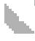
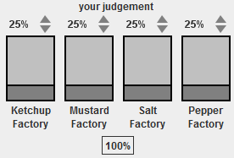
Methods: Questions
In an attempt to separate learning from inference, we also asked each participant to explicitly state feature-category relationships in a series of feature learning assessment questions.
(1-7) When a sector contains the building pictured (e.g. ), what is the probability of each facility type?
(8) When a sector contains water, what is the probability of each facility type?
(9) When any building in a sector contains the hardware pictured, what is the probability of each facility type?
(10) When a sector contains SIGINT, what is the probability of each facility type?
(11) When a sector contains MASINT1, what is the probability of each facility type?
(12) When a sector contains MASINT2, what is the probability of each facility type?
Participant Response:

Slide 9
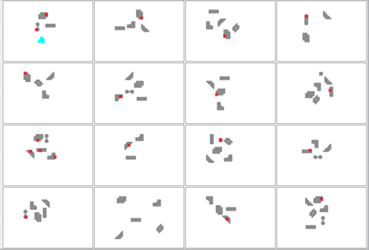
Methods: Training
Participants were trained via statistical learning (partially-annotated examples of each facility).
Annotation: 48 examples of each facility were presented, 16 at a time.
Training via example (16 instances of a Ketchup Factory shown; IMINT only).

Slide 10
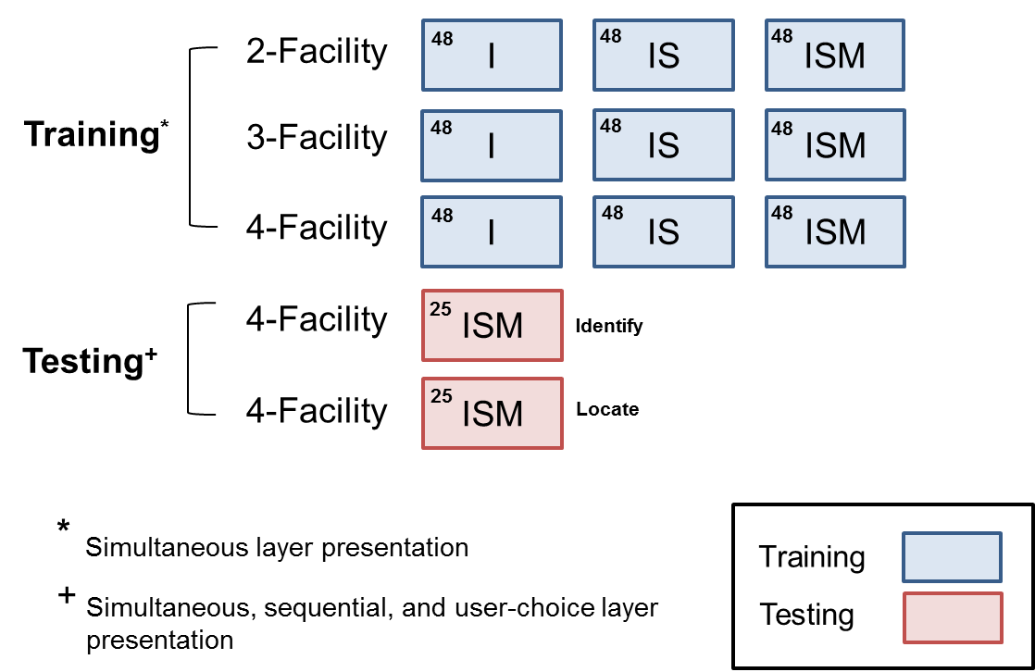
Methods: Structure
I = IMINT S = SIGINT M = MASINT
The experiment was divided into 2 sections: training and testing. The number of training examples (training) or questions (testing) is given in the upper-left corner of each box.
A small number of test questions were given between training blocks, to support participant engagement. These questions were not analyzed.

Slide 11
Learning: What was analyzed?
Data from 19 participants
MITRE employees
Divided between engineers and administrative personnel
50 questions
Identify and Locate questions
Simultaneous, Sequential and User Choice
Analyzed participant’s final answer (Sequential and User Choice)
Performance was not significantly different across question types, therefore data was pooled for analysis

Slide 12
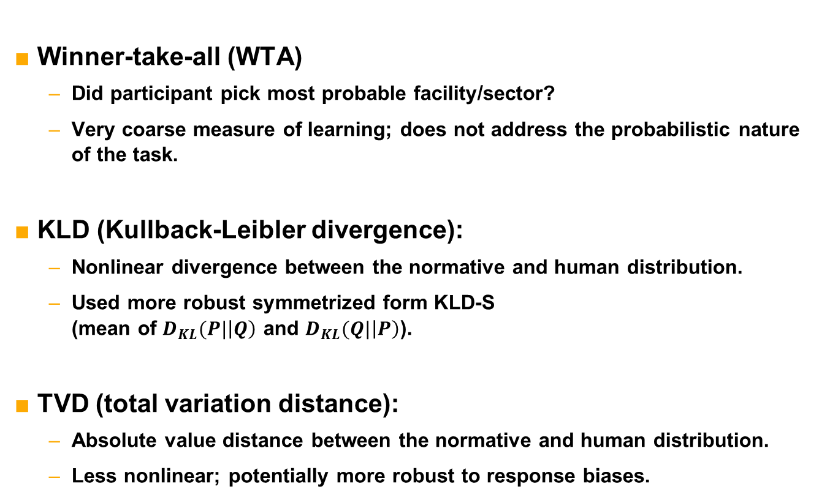
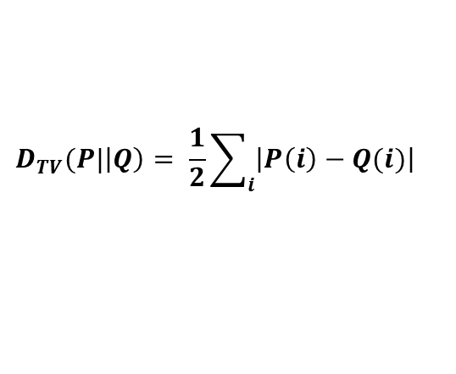
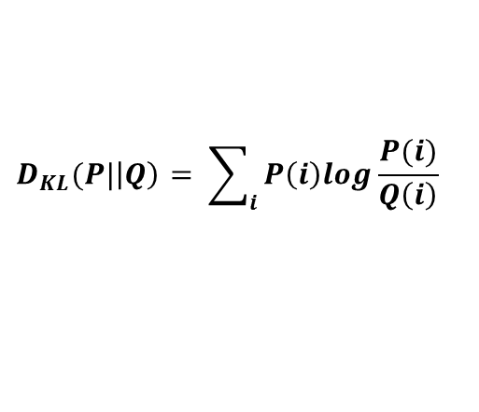
Metrics
Note: these metrics were considered to elucidate how and what participants learned in the Pilot Study. They will not necessarily be used in the final, Phase I evaluation.
Winner-take-all (WTA)
Did participant pick most probable facility/sector?
Very coarse measure of learning; does not address the probabilistic nature of the task.
KLD (Kullback-Leibler divergence):
Nonlinear divergence between the normative and human distribution.
Used more robust symmetrized form KLD-S (mean of $D_{KL}(P|\left|Q\right)$ and $D_{KL}(Q|\left|P\right)$).
TVD (total variation distance):
Absolute value distance between the normative and human distribution.
Less nonlinear; potentially more robust to response biases.
$$D_{KL}(P|\left|Q\right)= \sum_{i}{P\left(i\right)log\frac{P(i)}{Q\left(i\right)}}$$
$$D_{TV}(P|\left|Q\right)= \frac{1}{2}\sum_{i}{\left|P\left(i\right)−Q(i)\right|}$$

Slide 13
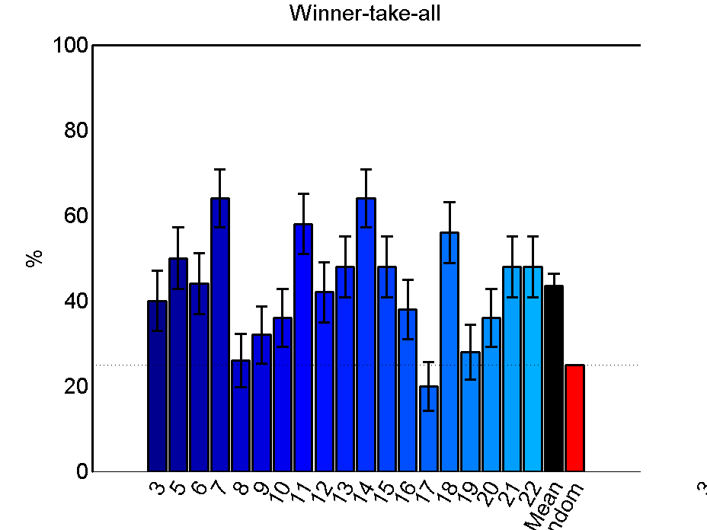
Participants learned to categorize facilities
p < 0.00001
Participants identified the correct facility at above-random rates (p < 0.00001).
>90% were above chance (25%).
3/19 got nearly 60% of the facilities correct.
Mean
error bars SEM
Subject
Random

Slide 14
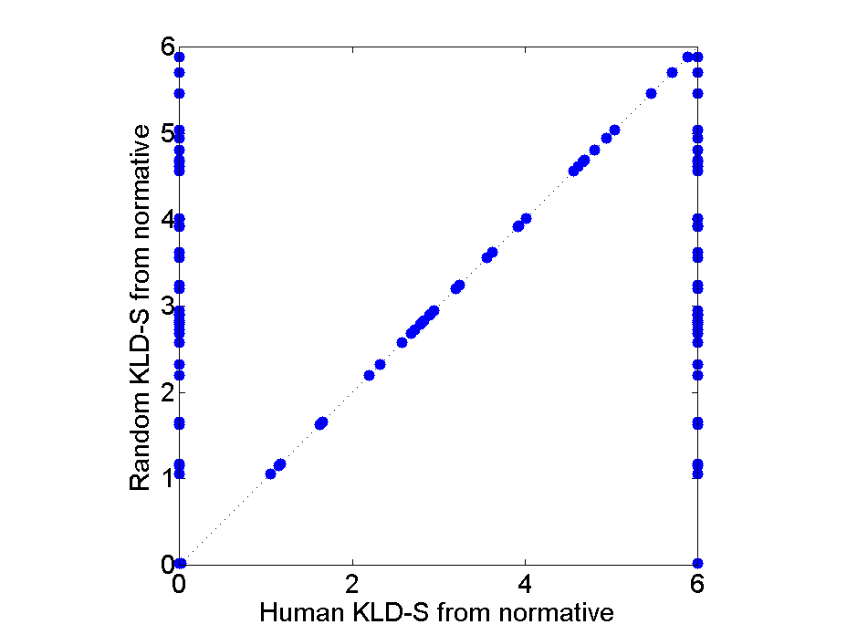
Evaluating participant performance using KLD/TVD
Normative response:
WTA proves that participants learned to categorize facilities, but responses were given as likelihoods. Here, we compare:
Humans’ divergence from normative (x-axis), to
A random model’s divergence from normative (y-axis)
Points to the left of the diagonal exceed random performance
A
B
C
D
Human response:
Human response:
Perfect
Random
A
B
C
D
Human response:
A
B
C
D
Random KLD from normative
Wrong
A
B
C
D
Human KLD from normative

Slide 15
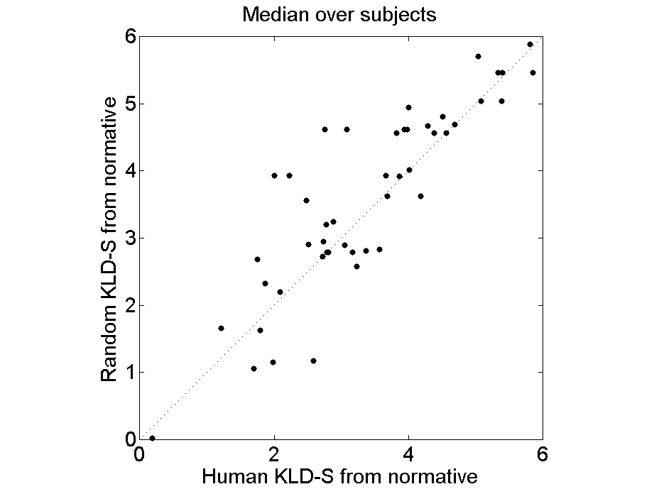
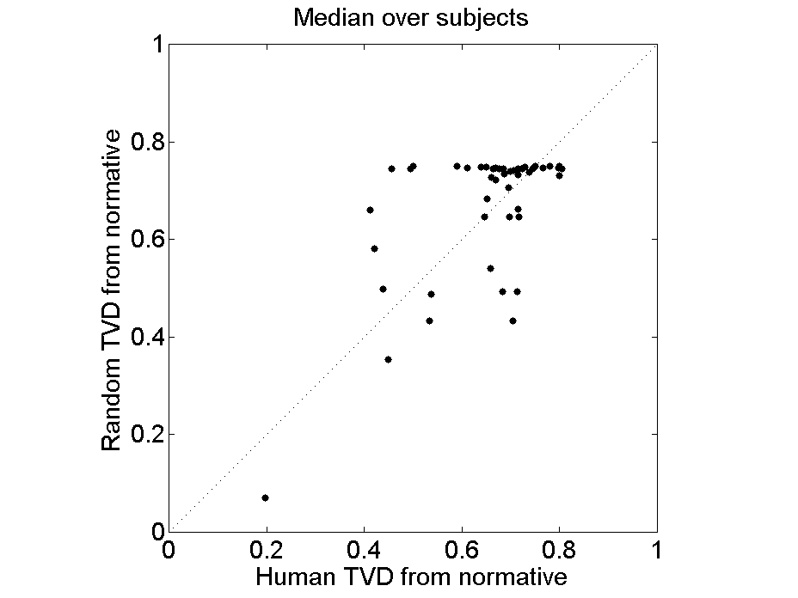
KLD/TVD, Median subject performance
Median performance measured via KLD was better than random with p = 0.055
Median performance measured via TVD was better than random with p < 0.0001

Slide 16
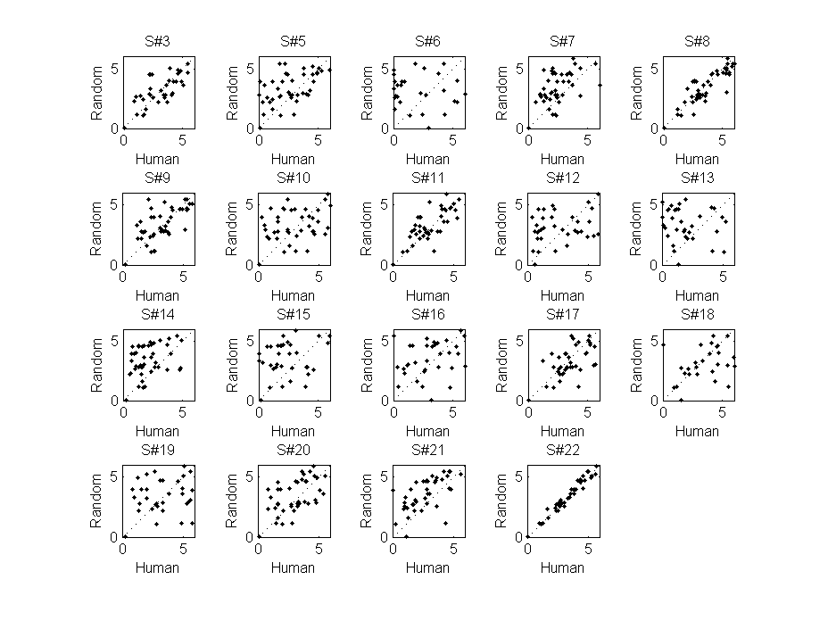
KLD, Individual performance
better than random with p < 0.05

Slide 17
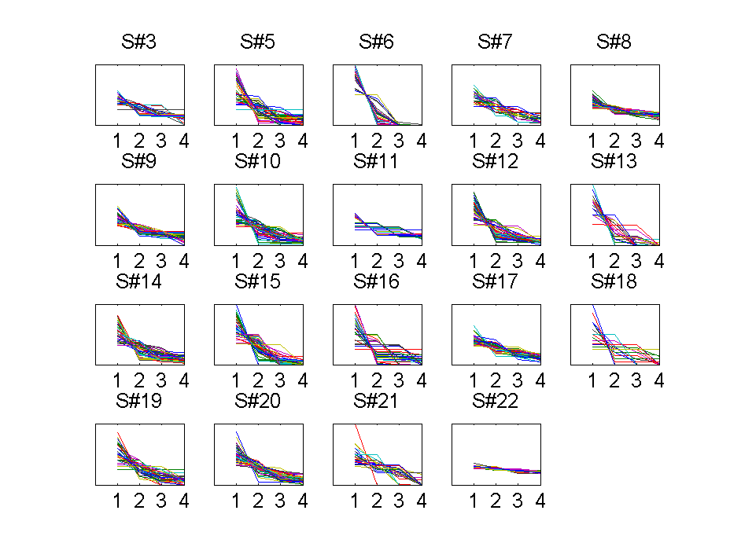
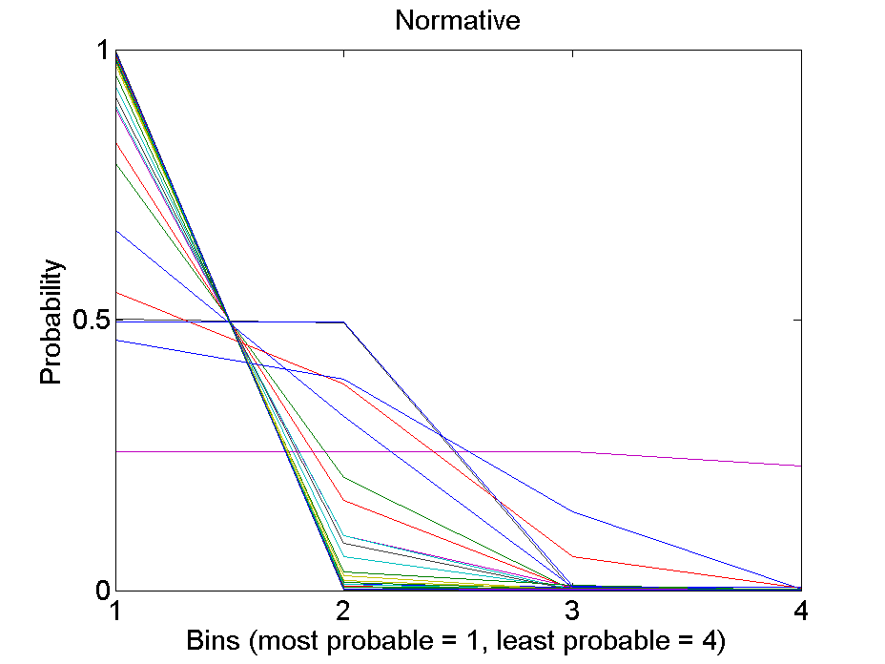
Participant judgments were much less peaked than the normative solution
3
2
4
1
1
2
3
4
1
2
3
4
Gini coeff.
Curves were rank-ordered:
0.4
A
B
C
D
This line is plotted below for each trial.
1 line = 1 trial
The normative solution was very peaked after all layers were revealed (the line is steeply sloped).
Few participants gave peaked responses (with some exceptions).

Slide 18
Participants fell into two response groups
Normative
# subjects
Less peaked responses
More peaked responses
Gini coefficient
All participants received the same directions, but a small number of subjects gave highly peaked answers.
Highly peaked responding subjects were not necessarily the best performers.
Notes:
Average Gini Coefficient per subject
Sequential and simultaneous layer trials in phases 19 and 20
The average human gini (mean = .41) is significantly less than the normative gini (mean = .90) (p < .01, t = -10.98, df = 18). Means drawn as dashed lines. Upper group: subjects 6, 13, 15.

Slide 19
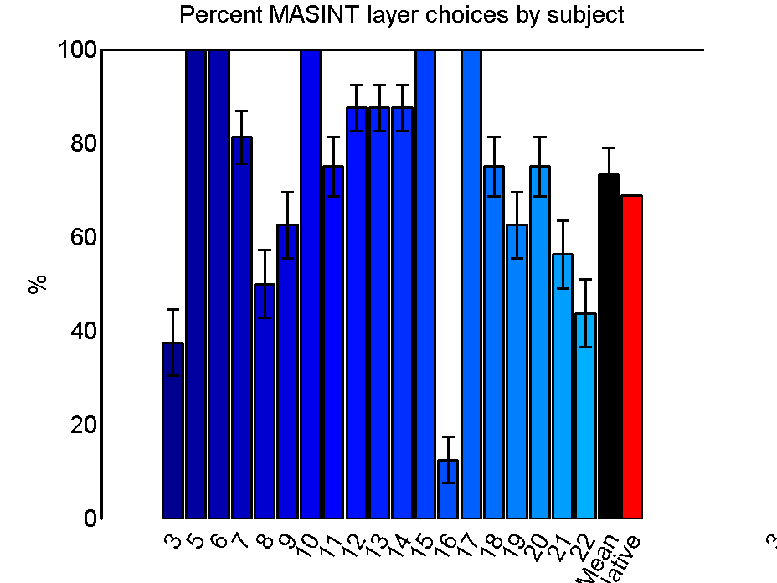
In user choice trials, almost all subjects chose the more informative layer, but multiple strategies were employed

Slide 20
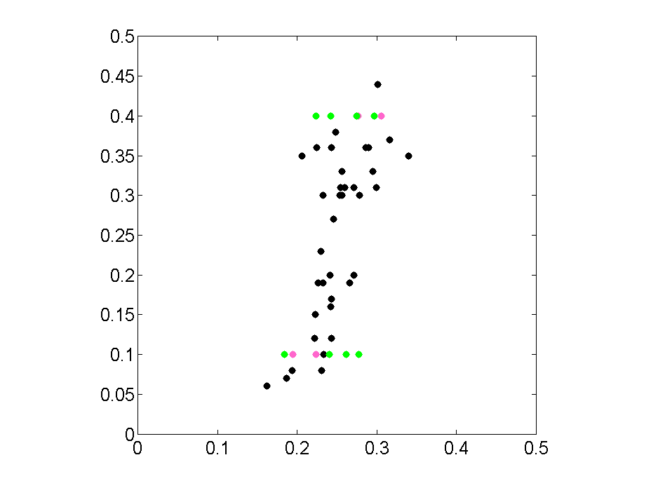
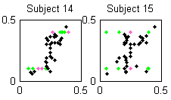
Participants learned conservatively
Normative
Human
Feature learning assessment responses (human) were compared to normative responses (below).
A perfect match falls on the diagonal (human = normative).
Normative
A
B
C
D
A
B
C
D
Human
Average
Participants were underconfident / conservative. On average, they did not learn feature-facility correlations effectively.
But some participants did (given 48 training examples; see below)
Normative
IMINT SIGINT MASINT
Human
All results shown in ‘backup’ slides.

Slide 21
Conclusions
Participants learned to identify/categorize the correct facility, but, on average, did not learn the underlying probability distributions well.
There was wide variation in participant performance.
The time-limited training paradigm was sufficient for some participants, but not optimal.
Probability elicitation via the UI may have been an issue.
Many issues of CP design, including testing protocols, normative solution generation, and data analysis were successfully addressed.

Slide 22
What types of training supported learning?
Exposure to multiple exemplars seemed to lead participants to focus on rules
Participants reported using about 3-5 different rules or strategies to identify facilities.
e.g. “If red and green triangles, then mustard. Circles plus no water, then ketchup. Plus others I can't remember.”
e.g. “The chemicals were the most consistent. none = ketchup, both = mustard, green = salt, red = pepper”
For rule learning, memory limits were an issue
All participants reported that they forgot some of the rules they developed over the course of the experiment.
Several participants reported that it was very difficult to learn the facilities due to the lack of feedback.

Slide 23
Backup

Slide 24
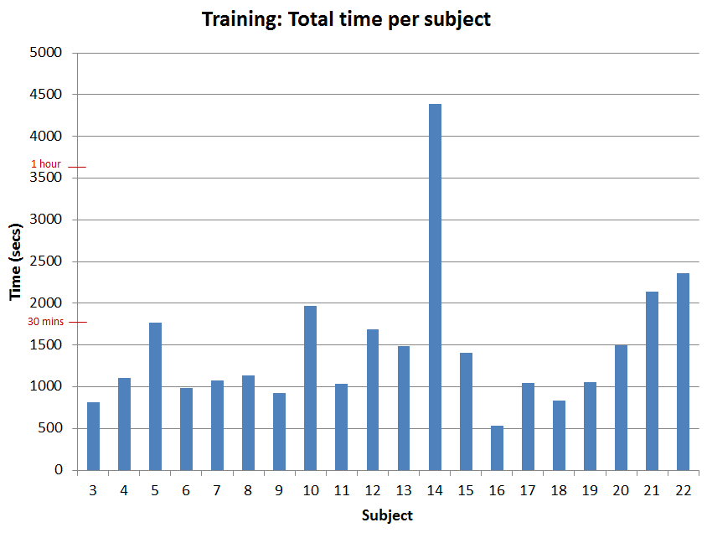
Training
Average time spent training: 24 min
(range 8.5 – 73 min)
Participants sped up (time per phase) through training

Slide 25
Response strategies
Participants who look longer on trials performed better.
Some participants manually normalized their responses and performed slightly better.
Others relied on the automatic GUI normalization process and were adversely affected.
* see slide notes for details
Notes:
Subjects’ reliance on GUI normalization and performance
Normalization compensation %: Is a measure of how much the graphical user interface (GUI) automatically normalized participants’ responses to 100%. This number is the average % per trial that the GUI “compensated” for the participants raw probability inputs. 0% represents participants who either a) manually normalized their responses to 100% or b) did not change the default GUI sliders on a trial. Values > 0% represent the GUI reducing the participants’ raw inputs by x% on average.
Things to note:
Five participants had normalization values ~ 0% . Of those five, four participants did actually move the sliders on all trials so they manually normalized their responses. The fifth participant (the red dot, S18) had a KLD = 3.58 and also had the highest percent of trials (23%) that they did not change the default slider values. This participant, therefore, “did not know” an answer for roughly a quarter of all their trials and might be considered an outlier.

Slide 26
Experiment 1: Detailed Structure
Experiment 1, Testing (Set 19 and 20)
Defined next slide…

Slide 27
Structure Key
Question {Identify, Locate}
The type of question.
Target {A, B, C, D}
The target facility (Identify/Locate Facility A).
Presentation {Simultaneous, Sequential, Choice}
The data was presented ‘simultaneously’ (all at once), ‘sequentially’ (one layer at a time), or ‘sequentially based on user choice’ (participants were asked which layer they would like to see next).
Order
Simultaneous {ISM}
IMINT (I), SIGINT (S), and MASINT (M) were presented simultaneously.
Sequential {I-S-M, I-M-S}
Choice {I-SM}
IMINT was presented first. Users could choose to see SIGINT or MASINT.
Scene {1-16}
Scene number. Multiple questions were asked per scene.

Slide 28
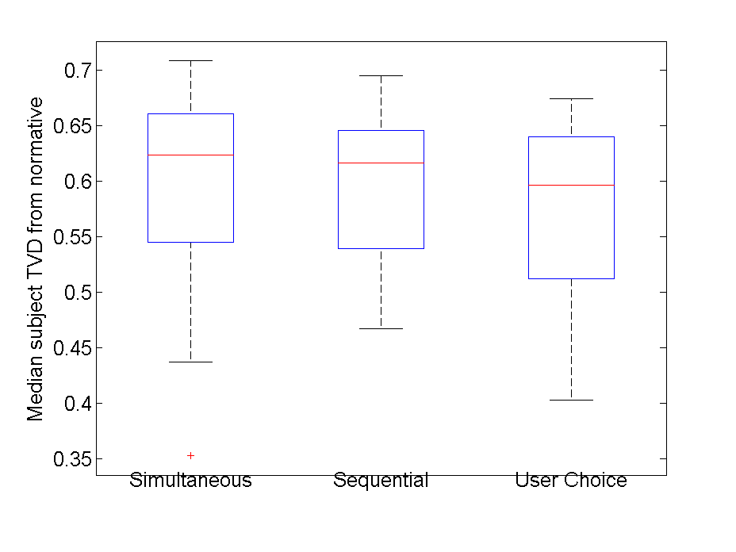
Performance in sequential trials was not significantly different from simultaneous or user choice

Slide 29
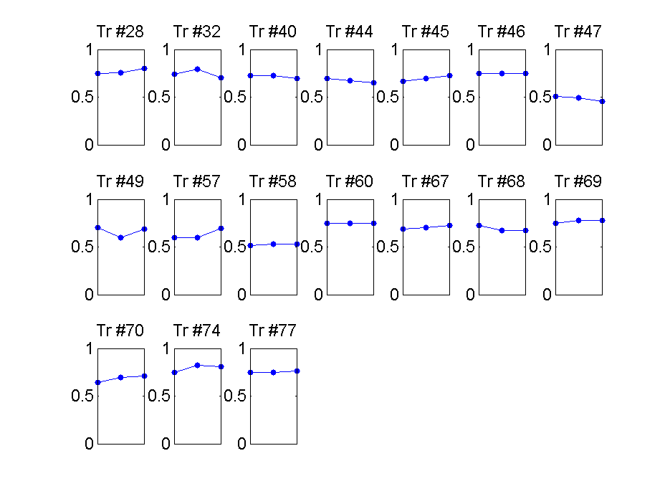
Participants did not improve significantly over sequential trials
Layer 1 - 2 - 3
Medians over subjects

Slide 30
Participants’ responses across sequential trials.
Trial response pattern |  | Percent of trials*
all correct | CCC | 24
all incorrect | WWW | 54
correct to wrong | CCW, CWW | 10
wrong to correct | WCC, WWC | 08
flip flop | CWC, WCW | 03
n = 323 total trials
Notes:
*Analyzed the sequential trials of phases 19 and 20. Each trial contained three likelihood distributions at t1, t2, and t3.
The highest % option for a given distribution was considered the subjects ‘most likely’ answer (e.g. for the distribution [.20 .60 .10 .10.] , option B was the subjects most likely).
The subjects’ ‘most likely’ responses were compared to the actual test ‘specified answer’ to determine if the subject was “correct” or “wrong”. (i.e. Correct if ‘most likely’ answer= ‘specified answer’. Wrong if most likely != specified answer)
The patterns of ‘most likely’ responses across t1, t2, and t3 were categorized as
all correct: t1 = correct t2 = correct t3 = correct
all wrong: t1 = wrong t2 = wrong t3 = wrong
correct to wrong: t1 = correct, t2 = correct, t3 = wrong OR t1 = correct, t2 = wrong, t3 = wrong
wrong to correct : t1 = wrong, t2 = correct, t3 = correct OR t1 = wrong, t2 = wrong, t3 = correct
flip flop : t1 = correct, t2 = wrong, t3 = correct OR t1 = wrong, t2 = correct, t3 = wrong

Slide 31
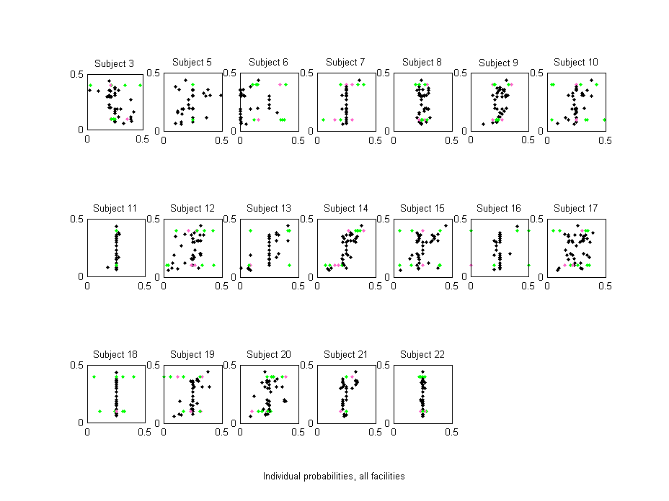
Feature Learning Assessment Responses

Slide 32
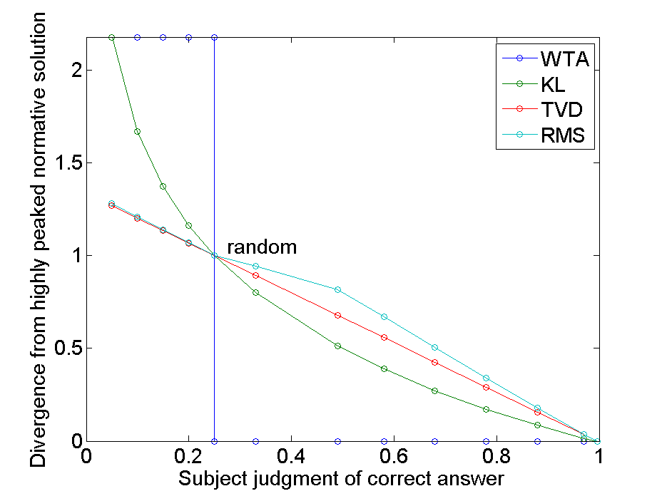
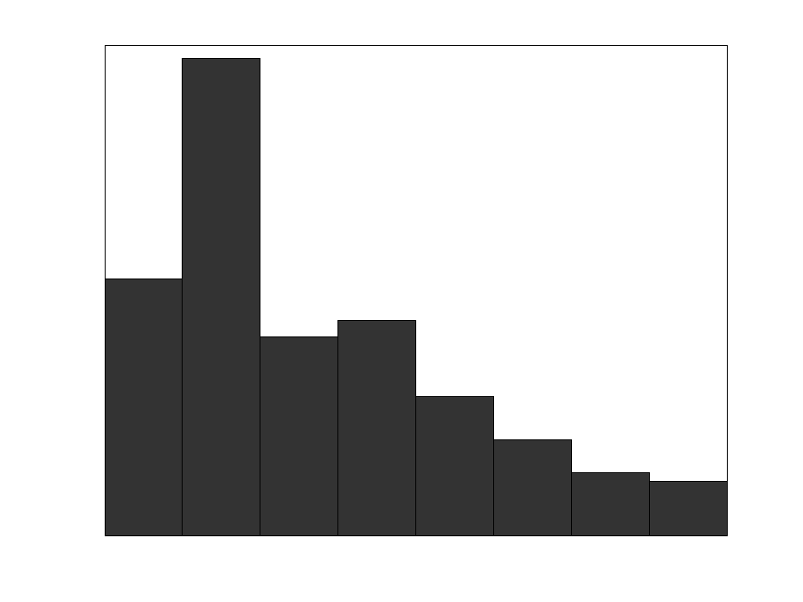
KLD exaggerated the effect of mistakes
KLD
When the normative solution is peaked (as it was here), KLD “exaggerates” mistakes due to its logarithmic nature.
mistaken
underconfident
correct
Observed participant judgments in pilot study

Slide 33
Evaluating participant performance using KLD
Normative response:
WTA proves that participants learned to categorize facilities, but responses were given as likelihoods. Here, we compare:
Humans’ divergence from normative (x-axis), to
A random model’s divergence from normative (y-axis)
Points to the left of the diagonal exceed random performance
A
B
C
D
Human response:
Human response:
Perfect
Random
A
B
C
D
Human response:
A
B
C
D
Random KLD from normative
Wrong
A
B
C
D
Human KLD from normative

Slide 34
KLD, Median subject performance
Average performance measured via KLD was better than random with p=0.055.

Slide 35
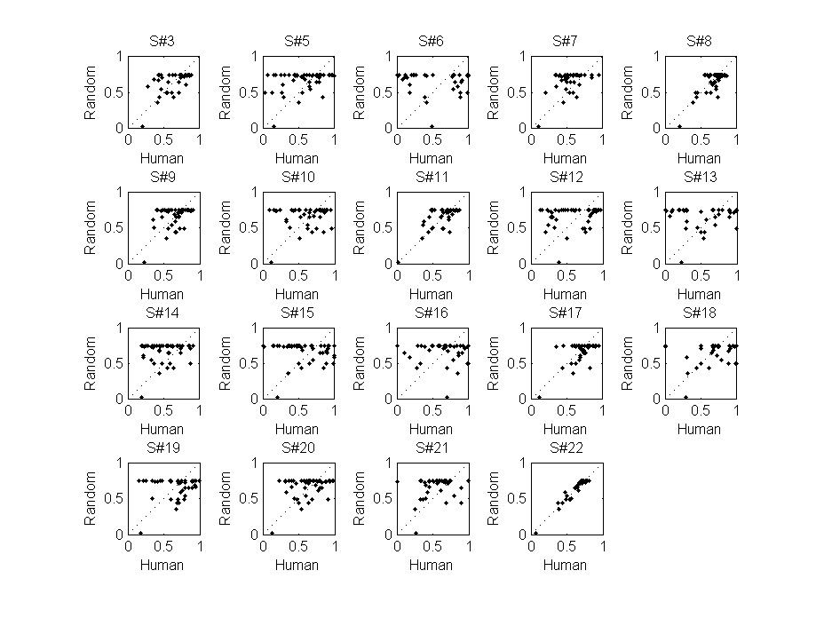
TVD, Individual performance
p < 0.05

Slide 36
Participants had mixed opinions about overall study
Participants were generally satisfied with clarity of directions and software usability
Test question difficulty was rated as fairly high
Engagement was rated slightly low
Question | Average Response (Scale)*
1. I think the study instructions were easy to understand. | 3.5
2. I think the study test questions were easy to understand. | 3.6
3. I think the study test questions were easy to answer. | 2.4
4. I think it was easy to use the computer software during the study. | 3.8
5. I think it was easy to input my answers using the probability sliders in the study. | 3.5
6. I felt like I was engaged or having fun during the study. | 2.7
7. I felt like I was interested in the study. | 3.2
8. I felt bored throughout the study. | 2.3
9. I felt tired throughout the study. | 2.9
*Response Scale
Strongly Disagree (1) | Disagree (2) | Neutral (3) | Agree (4) | Strongly Agree (5)
Notes:
Some participants did select the “strongly” options (1 or 5) on some questions so the entire scale was used.
No statistical power or confidence to these numbers. They are simply rough guidelines as to what direction participants were leaning in their opinions.
Subjects usually did not feel engaged or like they were having fun.
Test questions were easy to understand…not so easy to answer
Computer software and sliders were slightly positive and neutral respectively
Subjects felt slightly tired, but not overly bored

